Slide 1

STRATEGIC PLAYBOOK
Worst Case
Scenario
Playbook
What Happens If Everything Goes Wrong —
And What You'll Do About It
Pre-Mortem Thinking Framework
For High-Stakes Decision Making

Slide 2
01
THE MENTAL MODEL
The Goal Isn't to Avoid the Worst.
It's to Be Unafraid of It.
The Anxiety Paradox
Worry yang tidak terstruktur adalah parasit — menguras energi tanpa menghasilkan preparasi. Pre-mortem thinking adalah kebalikannya: menghabiskan sedikit waktu sekarang untuk mengeliminasi berbulan-bulan anxiety nanti .
Vague Anxiety vs. Defined Fear
Vague Anxiety
Mengambang, tidak terdefinisi
Menguras energi berkelanjutan
The Courage Formula
Tidak ada action plan
Orang yang paling berani dalam sejarah bukan yang tidak takut — mereka adalah yang sudah menghitung downside dan memutuskan itu acceptable. Clarity membebaskan.
Membuat paralysis
Defined Fear
Spesifik dan terukur
The Core Question
Bisa di-breakdown
Ada concrete response
"What is the actual worst that could happen — and could I survive it?" Ketika dijawab dengan jujur, jawabannya hampir selalu lebih manageable dari yang dibayangkan.
Membebaskan untuk action

Slide 3
02
RISK TAXONOMY
Not All Bad Outcomes Are Created Equal
Framework untuk klasifikasi skenario berdasarkan severity dan recovery timeline — mengapa hanya Crisis dan Catastrophic yang worth detailed planning.
1
2
3
4
5
Inconvenient
Setback
Crisis
Catastrophic
Existential
Recovery: 1-4 minggu
Recovery: 3-6 bulan
Recovery: 6-18 bulan
Recovery: 2-5 tahun
Recovery: Uncertain/permanent
Impact: Annoying, tidak ada lasting damage
Impact: Significant disruption, painful tapi manageable
Impact: Major impact, requires active intervention
Impact: Fundamental change, multi-year rebuild
Impact: Mengancam wellbeing dasar
Contoh: Project delay, minor budget cut
Contoh: Job loss dengan severance, major project failure
Contoh: Extended unemployment, major health issue
Contoh: Career change total, financial ruin, major disability
Contoh: Terminal illness, total identity loss
Handle as needed
Basic contingency plan
DETAILED PLANNING
DETAILED PLANNING
Prevention focus
Why Focus on Crisis & Catastrophic?
Level 1-2 bisa dihandle dengan common sense. Level 5 terlalu extreme untuk direncanakan secara realistis. Level 3-4 adalah sweet spot — cukup serius untuk dipersiapkan, tapi tidak terlalu extreme untuk direncanakan dengan actionable steps.

Slide 4
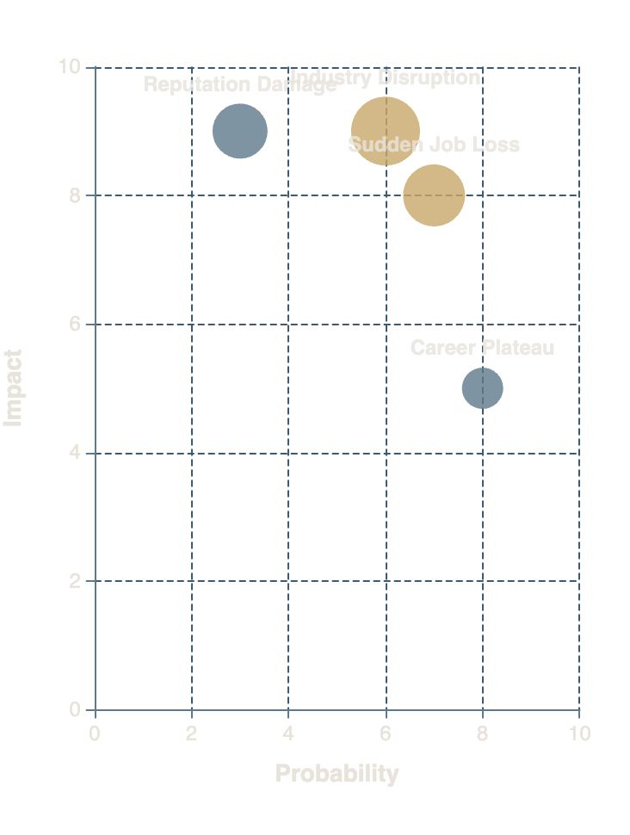
DOMAIN 1: CAREER
03
What If Your Professional Identity Disappeared Overnight?
Sudden Job Loss
Reputation Damage
Career Risk Matrix
Triggers: PHK tanpa warning, company tutup, role eliminated
Triggers: Public failure, workplace conflict eskalasi, industry blacklist
Early Signs: Hiring freeze, budget cuts, reorganization rumors
Early Signs: Excluded dari meetings, gossip intensifies, references dry up
30-Day Response: Update resume, activate network, apply strategically, assess finances
30-Day Response: Document facts, seek legal advice if needed, controlled narrative
Recovery: 3-9 bulan (industry dependent)
Recovery: 6-18 bulan (reputation rebuild)
Prevention: Keep skills current, maintain active network, know your market value
Prevention: Build portable reputation, maintain professional boundaries
Industry Disruption
Career Plateau
Triggers: AI automation, structural shift, regulation changes
Triggers: Terjebak di ceiling tanpa path forward
Early Signs: No promotion 3+ years, shrinking responsibilities, boredom
Early Signs: Declining demand, skill obsolescence warnings, industry contraction
30-Day Response: Honest conversation dengan manager, explore internal moves, external options
30-Day Response: Skill audit, identify transferable skills, explore adjacent industries
Recovery: 3-12 bulan (breakthrough atau exit)
Recovery: 6-24 bulan (career pivot)
Prevention: Regular career conversations, build visibility, develop T-shaped skills
Prioritas: Fokus pada kuadran kanan atas — high probability + high impact. Industry disruption dan sudden job loss memerlukan preparasi paling urgent.
Prevention: Continuous learning, diversify skillset, monitor industry trends

Slide 5
DOMAIN 2: FINANCIAL
04
What If the Money Stopped Tomorrow?
Total Income Loss
CRISIS LEVEL
Liquidity Ladder
Trigger: Semua income streams berhenti sekaligus
Crisis Point: >3 bulan tanpa income
1
Cash & Savings
Survival Budget: 50-70% dari spending normal
External Resources: Family, government assistance, liquidate assets
3-6 bulan expenses
Recovery Path: Emergency fund → Side income → Full employment (6-18 bulan)
2
Liquid Investments
Money market, short-term bonds
Savings Depletion
Debt Crisis
3
Sellable Assets
Stocks, valuables, secondary property
Trigger: Emergency fund habis lebih cepat
Trigger: Liabilities > kemampuan bayar
Warning: <3 bulan runway tersisa
Warning: Minimum payments >30% income
4
Credit Lines
Action: Drastic expense cut, asset liquidation
Action: Debt restructuring, negotiation
Home equity, personal line (last resort)
5
Retirement Accounts
Investment Wipeout
401k, IRA (penalty + taxes)
Trigger: Portofolio turun drastis saat dibutuhkan
Prevention: Asset allocation sesuai timeline
Survival Budget Formula
Recovery: Jangan panic sell, rebalance, dollar-cost average
Housing: 30-40% (minimum)
Food: 15-20% (basic nutrition)
Utilities: 5-10% (essential only)
Transport: 10-15% (work access)
Insurance: 10-15% (don't drop)
Misc: 5-10% (buffer)
Total: 50-70% dari normal spending

Slide 6
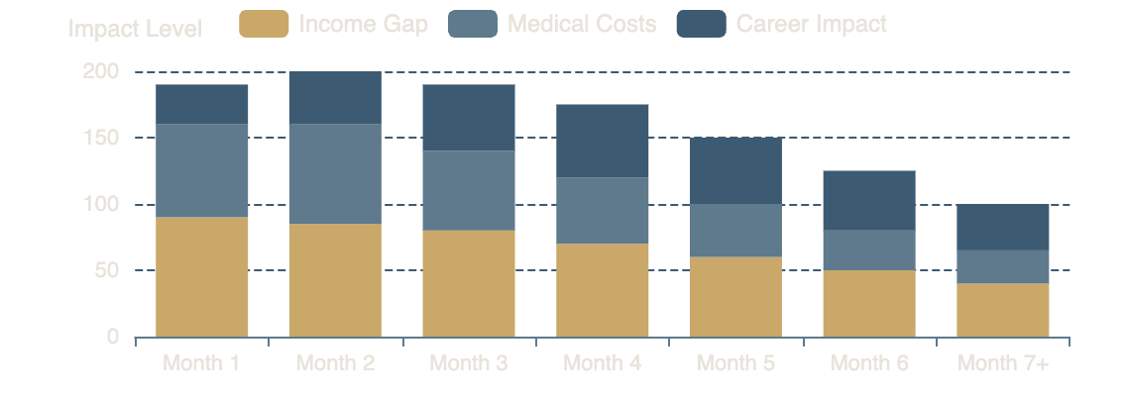
DOMAIN 3: HEALTH
05
What If You Couldn't Work for 6 Months?
Short-Term Incapacity
Health Emergency Impact Timeline
Duration: 1-3 bulan (illness, injury, surgery)
Financial Impact: Income gap + medical costs
Insurance: Short-term disability, sick leave
Work Arrangement: Remote, reduced hours, project-based
Support Activation: Family help, meal services, childcare
Long-Term Health Challenge
Duration: 6+ bulan (chronic condition, major illness)
Family Health Emergency
Financial Impact: Significant income loss + ongoing costs
Insurance: Long-term disability, critical illness, health max out-of-pocket
Scenario: Menjadi caregiver yang menguras waktu dan resources
Work Arrangement: Career pivot, part-time, disability accommodation
Financial Impact: Reduced work hours + care costs + emotional toll
Support Activation: Professional caregivers, support groups, financial counseling
Insurance: Check family coverage, FMLA eligibility
Work Arrangement: Flexible schedule, FMLA leave, remote work
Mental Health Crisis
Support Activation: Respite care, family rotation, community resources
Duration: Variable (burnout, depression, anxiety disorder)
Insurance Inventory Checklist
Financial Impact: Therapy costs + potential income interruption
Health (adequate coverage)
Disability (short & long-term)
Insurance: Mental health coverage, EAP programs
Life (income replacement)
Critical Illness (lump sum)
Work Arrangement: Medical leave, therapy schedule, workload adjustment
Accident (supplemental)
Hospital Indemnity (daily cash)
Support Activation: Therapist, psychiatrist, trusted friends, HR

Slide 7
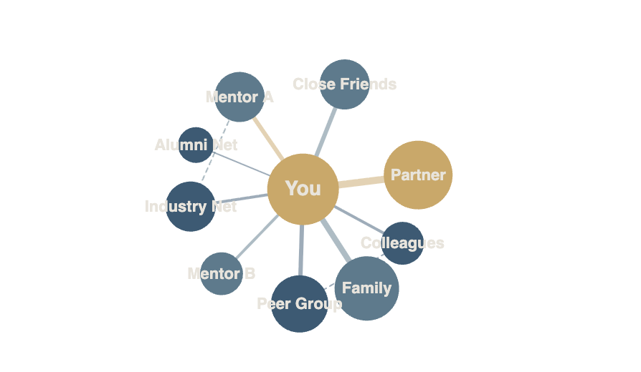
DOMAIN 4: RELATIONSHIPS
06
What If You Lost Your Strongest Anchors?
Key Mentor/Sponsor Loss
Support System Dependency Map
Impact: Orang yang paling banyak membuka pintu tidak lagi available
Triggers: Mereka pindah, retire, conflict, atau fokus shift
Early Warning: Reduced communication, cancelled meetings, less advocacy
Response: Identify alternative sponsors, expand network strategically, build independent reputation
Prevention: Diversify mentor relationships, don't rely on single sponsor
Network Collapse
Personal Support Breakdown
Impact: Perpindahan industri/geografi memutus koneksi
Impact: Kehilangan support system personal yang mempengaruhi work
Triggers: Career pivot, relocation, industry exit
Triggers: Relationship end, family conflict, friend drift
Dependency Audit Questions
Response: Proactive networking di new space, maintain old connections remotely
Response: Therapy, rebuild social circle, focus on self-care
• Seberapa concentrated support system saat ini?
Prevention: Build portable network, maintain diverse connections
Prevention: Maintain relationships, don't neglect personal life for career
• Berapa banyak key relationships yang "single point of failure"?
• Hubungan mana yang akan survive major life disruption?
• Siapa yang akan tetap ada bahkan di worst case?
Key Collaborator Departure
• Bagaimana mendiversifikasi support sebelum butuh?
Impact: Partner bisnis atau kolega kunci pergi
Triggers: Resignation, termination, business dissolution
Response: Knowledge transfer, relationship maintenance, find new partners
Prevention: Document processes, cross-train, legal agreements

Slide 8
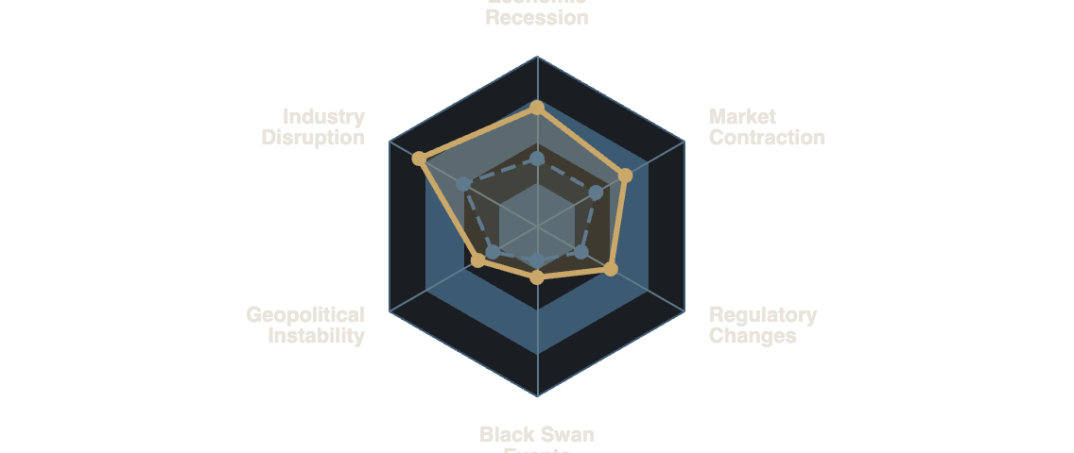
DOMAIN 5: EXTERNAL
07
What If the World Changed the Rules?
Economic Recession
External Shock Exposure Radar
Impact: Hiring freeze, budget cuts, salary pressure, layoffs
Exposure: Industry cyclicality, company financial health, role criticality
Hedging: Recession-resistant skills, emergency fund, diversify income
Optionality: Multiple job offers, side business, transferable skills
Antifragile: Skills yang lebih valuable saat krisis (cost optimization, efficiency)
Industry Disruption
Impact: AI, regulation, market shift mengubah entire landscape
Exposure: Task automation potential, regulatory dependency, market concentration
Hedging: Human-centric skills, compliance expertise, adaptability
Building Antifragility
Optionality: Cross-industry experience, adjacent skill development
Barbell Strategy: 90% safe + 10% high-risk/high-reward
Antifragile: Become the disruptor, lead transformation, AI augmentation
Optionality: Maintain multiple paths, don't overcommit
Redundancy: Backup plans for critical systems
Geopolitical Instability
Black Swan Events
Skin in the Game: Align incentives, have stakes
Via Negativa: Remove fragility rather than add robustness
Impact: Career mobility, financial assets
Impact: Pandemic, unexpected macro disruption
Hedging: Geographic flexibility, diversified assets
Hedging: Emergency preparedness, financial buffer
Optionality: Remote work capability, multiple residencies
Optionality: Multiple income streams, location independence

Slide 9
THE PRE-MORTEM METHOD
08
Fast Forward to Failure — Then Work Backward
Teknik yang dipopulerkan oleh Gary Klein untuk decision makers high-stakes: bayangkan kegagalan sudah terjadi, lalu identifikasi penyebabnya sebelum failure terjadi.
1
Pilih Keputusan
4
Kategorisasi
Pre-Mortem Worksheet
Pilih satu keputusan besar yang sedang dipertimbangkan: resign, pivot karier, investasi besar, venture baru, relocation.
Identify mana yang bisa dicegah vs mana yang di luar kontrol.
Keputusan yang Dianalisis:
Preventable
Skenario Kegagalan (12 bulan):
Insufficient research, poor timing, skill gaps, no backup plan
2
Bayangkan Kegagalan
Uncontrollable
Penyebab Kegagalan:
Bayangkan 12 bulan dari sekarang, keputusan itu gagal total . Bukan "mungkin gagal," tapi sudah pasti gagal.
Market crash, company bankruptcy, health emergency
5
Action untuk Preventable
3
List Penyebab
Untuk yang bisa dicegah — apa action-nya sekarang? Research lebih, skill up, build runway.
List semua hal yang berkontribusi pada kegagalan itu. Jangan sensor — tulis semua yang terpikir.
Preventable Actions:
Contingency Plans:
6
Contingency untuk Uncontrollable
Untuk yang di luar kontrol — apa contingency-nya jika terjadi? Exit strategy, safety nets.
Template ini bisa di-copy dan digunakan untuk setiap keputusan besar.

Slide 10
BUILDING RESILIENCE
09
Hope Is Not a Strategy. Safety Nets Are.
Framework komprehensif untuk membangun safety net sebelum dibutuhkan — 4 layer protection untuk berbagai jenis crisis.
Financial Safety Net
Relational Safety Net
The Foundation Layer
The Social Layer
Emergency Fund: 6-12 bulan expenses (liquid, untouched)
Crisis Contacts: People yang bisa dihubungi tanpa awkwardness
Income Diversification: Minimal 2 income streams
Support Community: Non-financial support (emotional, practical)
Insurance Coverage: Health, disability, life, critical illness
Mentors: Yang tahu situasi sebenarnya
Liquidity Ladder: Tiered access to funds (cash → investments → assets)
Professional Allies: Willing to vouch for you, open doors
Zero Debt Goal: Eliminate high-interest debt, manage low-interest strategically
Family Safety: Clear communication, mutual support agreements
Career Safety Net
Psychological Safety Net
The Professional Layer
The Mental Layer
Marketable Skills: Selalu current dan transferable
Identity Beyond Job: Tidak 100% tied ke job title
Active Network: Tidak dormant — regular engagement
Coping Mechanisms: Yang sudah terbukti work
Portable Reputation: Tidak tergantung satu employer
Clarity About "Enough": Apa yang benar-benar dibutuhkan untuk survive
Industry Visibility: Personal brand, thought leadership
Stress Management: Regular practices (exercise, meditation, therapy)
Side Projects: Proof of ability outside day job
Perspective: Historical context — crisis adalah temporary
The Layered Defense Principle
Setiap layer adalah backup untuk layer di atasnya . Ketika financial safety net terkuras, career safety net bisa generate income baru. Ketika career terhambat, relational safety net bisa buka pintu. Dan psychological safety net memastikan kamu tidak collapse sebelum layer lain bisa diaktifkan.

Slide 11
IMMEDIATE RESPONSE
10
When It Hits — What Do You Do in the First 72 Hours?
Playbook konkret untuk 72 jam pertama setelah worst case terjadi. Struktur dan clarity di saat chaos.
24H
STABILIZE
48H
ASSESS
72H
ACTIVATE
Hour 0-24
Hour 24-48
Hour 48-72
Tahan Diri
Full Inventory
Execute First Steps
Jangan buat keputusan besar dalam 24 jam pertama. Emotion clouds judgment.
Apa yang hilang? Apa yang masih ada? Cash, assets, relationships, skills.
Apply for jobs, contact network, file claims, negotiate payments.
Assess Factually
Immediate Obligations
Activate Safety Nets
Apa yang sebenarnya terjadi? Tulis facts, bukan interpretations.
Bills, rent, loan payments yang due dalam 30 hari.
Unemployment benefits, insurance claims, family support.
Communicate
Communication Rhythm
Hubungi Advisors
Stakeholders yang perlu tahu: family, employer, creditors (proactive).
Schedule regular check-ins dengan support system.
2-3 trusted people yang bisa memberikan perspective objektif.
Set 30-Day Metrics
30-Day Survival Plan
Apa yang harus terjadi dalam 30 hari agar situasi terkendali?
Amankan Finances
Budget, income sources, cost-cutting measures.
Stop semua non-essential spending. Freeze subscriptions.
Goal: Stop the bleeding. Jangan memperburuk.
Goal: Clarity tentang situasi sebenarnya.
Goal: Momentum. Action beats anxiety.
Key Principle: Structure Beats Chaos
72 jam pertama adalah yang paling kritis — bukan karena decisions yang harus dibuat, tapi karena emotional state yang akan menentukan semua decisions selanjutnya. Protocol ini memberikan struktur ketika everything feels overwhelming.

Slide 12
THE REBUILD
11
From Worst Case to New Normal — The Rebuild Map
Framework untuk recovery setelah worst case terjadi. Recovery bukan kembali ke titik sebelum — tapi membangun sesuatu yang lebih tahan terhadap shock berikutnya.
1
TRIAGE
2
REBUILD
3
MOMENTUM
4
BETTER
0-30 Hari
1-3 Bulan
3-6 Bulan
6-18 Bulan
Stabilisasi immediate
Re-establish baseline
Begin proactive moves
Incorporate lessons
Stop the bleeding
Stability
Bukan hanya reactive
Build antifragile system
Survival mode activation
Income restoration begins
Strategic choices
More resilient than before
Prioritas: survival & clarity
Routine re-establishment
Bukan default path
New opportunities seized
Bukan optimization
Identify leverage points
Opportunity identification
Relationships strengthened
Basic needs met
Small wins accumulation
Confidence rebuilding
Skills expanded
No major decisions
Support system solidified
Network re-engagement
Confidence higher
Mindset: "Just survive."
Mindset: "One step at a time."
Mindset: "I'm back in control."
Mindset: "What I learned."
The Antifragile Principle
Goal dari preparasi bukan kembali ke kondisi sebelum — tapi membangun sesuatu yang lebih tahan terhadap shock berikutnya. Setiap crisis adalah opportunity untuk rebuild stronger. Research menunjukkan: orang yang survive major setbacks sering menjadi more successful dalam jangka panjang karena lessons learned dan resilience built.

Slide 13
SELF-ASSESSMENT
12
What Are You Actually Afraid Of?
Self-assessment framework untuk mengidentifikasi, mengklasifikasikan, dan memprioritaskan worst case scenarios yang paling relevan untuk Anda.
Personal Worst Case Inventory
Step-by-Step Process
Scenario
Level
Prob
Prep
Gap
1
List 3-5 worst case scenarios yang sering muncul di pikiran
2
Classify di spectrum (Inconvenient sampai Existential)
1. Job loss without severance
Crisis
7/10
5/10
-2
3
Rate preparedness saat ini: 1-10
2. Industry disruption (AI)
6/10
4/10
-2
4
Calculate gap (Probability - Preparedness)
Crisis
Prioritize mana yang butuh attention paling urgent
5
3. Major health emergency
Cata
4/10
3/10
-1
Your Top Priorities
4. Financial market crash
Setback
5/10
7/10
+2
1. Job Loss Preparedness
5. Key mentor loss
Setback
5/10
6/10
+1
Score: 35 | Build emergency fund, update resume, activate network
2. Industry Disruption
Gap Analysis Formula
Score: 36 | Learn AI-augmented skills, diversify expertise
Priority Score = Probability × (10 - Preparedness)
Insight: Bukan scenario dengan impact tertinggi yang paling urgent — tapi scenario dengan gap terbesar antara probability dan preparedness .
Higher score = lebih urgent untuk diaddress
• Job loss: 7 × (10-5) = 35 ← TOP PRIORITY
• Industry disruption: 6 × (10-4) = 36 ← TOP PRIORITY
• Health emergency: 4 × (10-3) = 28
• Market crash: 5 × (10-7) = 15
• Mentor loss: 5 × (10-6) = 20

Slide 14
ACTION PLAN
You Can't Prepare for Everything. But You Can Prepare for the Most Likely.
13
Action plan konkret untuk meningkatkan preparedness dalam 90 hari — dari audit sampai dokumentasi playbook.
M1
AUDIT & IDENTIFY
M2
BUILD
M3
TEST & DOCUMENT
Days 1-30
Days 31-60
Days 61-90
Financial Safety Net Audit
Close Critical Gaps
Document Playbook
Emergency fund status, insurance coverage, liquidity ladder
Emergency fund, insurance, skill development
For each top scenario — 72-hour protocol, contacts, resources
Activate Dormant Relationships
Identify Top 3 Scenarios
Reach out sebelum butuh — 2-3 people per week
Communicate Plan
Dari personal worst case inventory
Share dengan key trusted people
Review Insurance Coverage
Map Current Safety Net Gaps
Health, disability, life — adequate?
Schedule Annual Review
Where are you most vulnerable?
Set calendar reminder — update setiap tahun
Build Side Income Stream
Career Risk Assessment
Start small — consulting, freelance, passive income
Test Emergency Systems
Skill relevance, network strength, market value
Can you access funds? Do contacts respond?
Deliverable: Gap analysis report
Deliverable: Measurable improvements
Deliverable: Complete playbook document
Weekly Commitment
Annual Review Cycle
Dedicate 2-3 hours per week untuk preparedness activities. Bukan overwhelming — tapi consistent. Small actions compound.
Set annual reminder untuk review dan update playbook. Life changes — scenarios, probabilities, dan preparedness berubah.

Slide 15

Fear the Unprepared,
Not the Worst Case
The Worst Case Rarely Destroys People. Unpreparedness Does.
Hampir setiap orang yang pernah menghadapi worst case dan survive mengatakan hal yang sama: lebih manageable dari yang dibayangkan — dan sering menjadi turning point terbaik dalam hidup mereka.
Yang menghancurkan bukan event-nya — tapi tidak tahu harus melakukan apa ketika event itu terjadi.
Prepare for the worst. Expect the best. And stop wasting energy worrying about things you haven't actually thought through.
You Are Now Prepared.
Go take that calculated risk.

