Slide 1

Strategic Self-Assessment
Personal
Moat Analysis
What Makes You Truly Irreplaceable?
Framework
Strategic Tool
5-Dimensional Assessment
For Ambitious Professionals

Slide 2

01
Opening Provocation
Everyone is replaceable.
Until they're not.
The AI Era Challenge
The Only Person
In an age of artificial intelligence and global outsourcing, what remains genuinely irreplaceable about you?
It's not about working harder—it's about becoming the only person who can execute X + Y + Z simultaneously.
The Core Question
"What unique combination of skills, experiences, and perspectives makes you uniquely valuable—not just better, but different in ways the market rewards?"
This deck will help you find—and articulate—that answer.

Slide 3
02
Concept Foundation
Your Moat = The Gap
Between You and Your Closest Competitor
From Economic to Personal
The Five Protective Layers
In investing, an economic moat is a sustainable competitive advantage that protects a business from rivals. Personal Moat is the human equivalent.
Rare Skills
1
Hard-to-acquire capabilities
Business Moat
Personal Moat
Brand, patents, network effects, scale
Skills, experiences, network, reputation, cognition
2
Unique Experiences
Irreplicable journey
Key Insight
3
Network Depth
A moat isn't about being BETTER—it's about being DIFFERENT in ways that are VALUABLE.
Quality relationships
4
Reputation Assets
Social proof & credibility
5
Cognitive Edge
Distinctive thinking

Slide 4
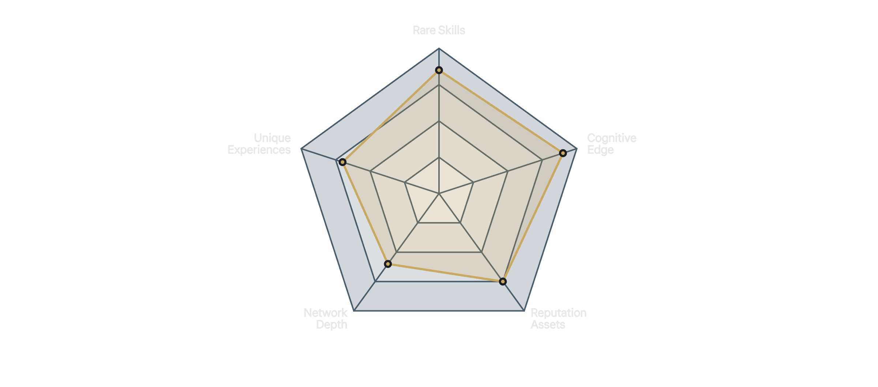
03
Framework Overview
Five Layers That Make You Defensible

Slide 5
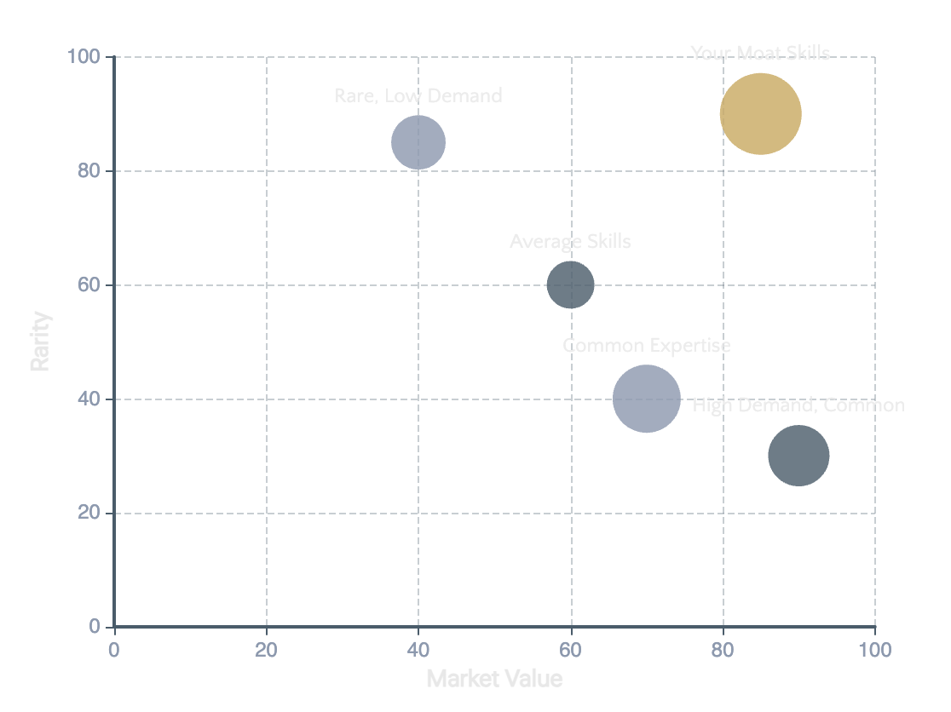
04
Dimension 1
Rare Skills
What Can You Do That Few Others Can?
Identifying Rare Skills
Skill Rarity vs. Market Value Matrix
Hard Skills Uncommon in Your Industry
Technical capabilities that aren't standard in your role or sector—e.g., a marketer who can code, a lawyer who understands data science.
Cross-Domain Combinations
The intersection of two or more disciplines creates rare expertise—e.g., finance + behavioral psychology, engineering + design thinking.
The 1% Test
Are you in the top 1% of this skill? Top 10%? What combination puts you in an even smaller percentile?
Key Question
"If I listed my top 3 skills on LinkedIn, how many people in my network could claim the exact same combination?"

Slide 6
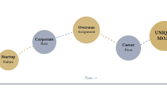
05
Dimension 2
Unique Experiences
Your Résumé Is a Story No One Else Can Tell
Sources of Experience Moat
Your Experience Accumulation
1
Unusual Career Paths
Non-linear journeys that create unique perspectives—career switches, industry hopping, unconventional roles.
2
Rare Combinations
Industries, geographies, or roles rarely combined—e.g., emerging market experience + tech startup + Fortune 500.
3
"Scar Tissue"
Failures, crises, and setbacks that produced expensive wisdom—lessons that can't be taught, only earned.
Reframe Your Story
"What seems like a 'messy' background is often your greatest asset. The dots only connect looking backward."
Each experience layer compounds into an irreplicable combination

Slide 7
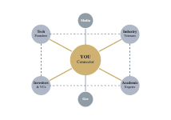
06
Dimension 3
Network Depth
Who Can You Call at Midnight?
Quality Over Quantity
Your Network Position
Strong Ties
Deep relationships with people who would help you without hesitation—mentors, collaborators, friends in high places.
Access to Inner Circles
Direct lines to decision-makers, knowledge hubs, and gatekeepers—not just knowing them, but being trusted by them.
Network Arbitrage
Being the bridge between two disconnected communities—e.g., connecting tech founders with traditional industry executives.
The Midnight Test
"How many people would pick up your call at midnight and actually help? That's your true network depth."
Your value = the connections you enable between disconnected worlds

Slide 8
07
Dimension 4
Reputation Assets
What Do People Say When You Leave the Room?
Components of Reputation
Evidence Inventory Checklist
Documented Social Proof
Publications & Content
Publications, speaking engagements, awards, media mentions, testimonials—evidence that others vouch for you.
Articles, books, white papers, blog posts
Institutional Credibility
Speaking & Media
The reputation of organizations you've been part of—prestigious companies, universities, or institutions that signal quality.
Conferences, podcasts, interviews, panels
Domain Authority
Awards & Recognition
Who comes to you for advice? Being the "go-to person" for a specific problem or topic.
Industry awards, honors, rankings
Personal Brand Attachment
Testimonials & References
Your name becomes associated with specific expertise—when people think X, they think of you.
LinkedIn recommendations, client feedback
Institutional Pedigree
Top companies, universities, organizations
Domain Association
The Room Test
What topic is your name linked to?
"If someone asked about you in a room full of professionals, what would they say? That's your reputation in action."
Audit: Which boxes can you check? Which need building?

Slide 9
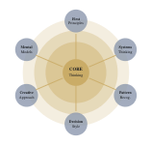
08
Dimension 5
Cognitive Edge
It's Not What You Know — It's How You Think
The Hardest to Replicate
Your Cognitive Profile
Skills can be taught. Experiences can be gained. Networks can be built. But how you think—your mental models, pattern recognition, and decision-making style—is uniquely yours.
Mental Models
Pattern Recognition
First principles thinking, systems thinking, inversion, second-order thinking—your unique toolkit for problem-solving.
Seeing connections across domains that others miss—transferring insights from one field to another.
Decision Style
"Signature Problems"
How you make choices under uncertainty—your risk tolerance, speed vs. accuracy balance, intuition vs. data.
What types of challenges do you solve differently? Complex ambiguity? High-stakes negotiations? Creative blocks?
The Ultimate Moat
"Your thinking style is the one thing AI can't replicate—and the one thing that compounds most over time."
Your unique configuration of mental models

Slide 10
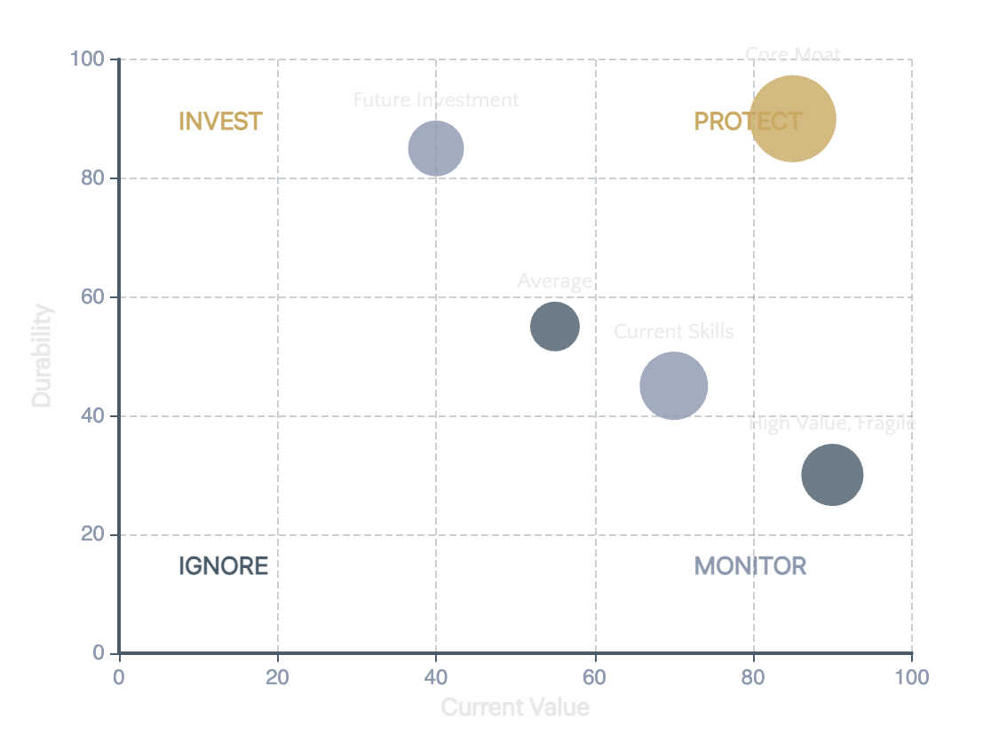
09
Strategic Assessment
Moat Durability Test
Will Your Moat Survive the Next 10 Years?
Four Dimensions of Durability
Durability vs. Current Value Matrix
AI Resistance Score
How difficult is it to automate your core skills? Creative judgment, emotional intelligence, and complex negotiation are highly resistant.
Trend Alignment
Is your moat growing or shrinking with industry changes? Are you riding a wave or swimming against it?
Transferability
Can your moat be applied to different contexts or industries? Narrow expertise is fragile; transferable skills are resilient.
Deepening Potential
Does your moat get harder to replicate over time? Network effects, accumulated wisdom, and compound skills strengthen with age.

Slide 11
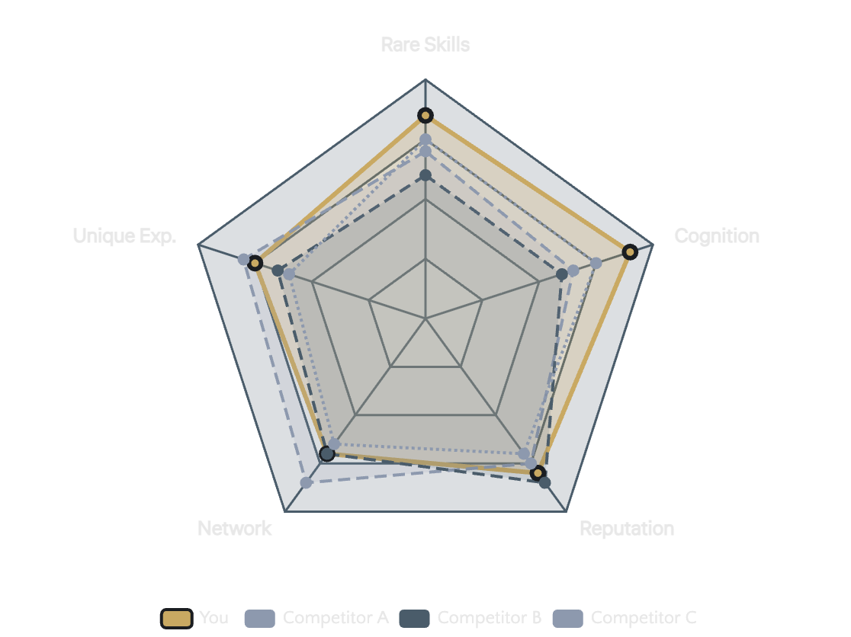
10
Market Positioning
Competitive Landscape
Where Do You Stand vs. The Field?
Mapping Your Position
Competitive Positioning Map
Identify Your Competitors
Who are the 5-10 people most similar to you in skills, experience, and positioning? These are your true competitors.
Assess Relative Strengths
For each dimension of your moat, rate yourself: Clearly Ahead | On Par | Behind. Be brutally honest.
Find the White Space
What unique position is unoccupied? Where can you be the ONLY person who does X + Y + Z?
The White Space Opportunity
"The most valuable position is often not where everyone is competing—it's the empty space no one has claimed yet."

Slide 12
11
Articulation Framework
Your Moat Statement
Can You Articulate It in 60 Seconds?
The Template
Fill in Your Moat Statement
"I am uniquely positioned to [deliver outcome] for [target audience] because [rare combination of X + Y + Z] ."
1. Your Outcome
What specific result do you deliver?
e.g., "reduce customer churn by 30%"
2. Your Target Audience
Strong vs. Weak Examples
Who specifically do you help?
STRONG
"I help Fortune 500 companies enter emerging markets by combining 10 years of on-the-ground Asia experience with McKinsey strategy training and fluency in 3 regional languages."
e.g., "B2B SaaS startups scaling from $1M to $10M ARR"
3. Your Rare Combination
WEAK
What unique mix makes you irreplaceable?
"I'm a passionate marketing professional with strong communication skills and a track record of success."
e.g., "data science + behavioral psychology + 50+ product launches"
Practice until it feels natural, not arrogant

Slide 13
12
Action Plan
Moat Strengthening Roadmap
Gaps Today = Opportunities Tomorrow
Quick Wins
Strategic Bets
Long Game
0–3 Months
3–12 Months
1–3 Years
Document existing achievements (LinkedIn, portfolio)
Take on a high-visibility cross-functional project
Become known as THE expert in a niche
Build a personal brand through consistent content
Reach out to 3 dormant high-value connections
Build relationships in an adjacent industry
Publish one piece of thought leadership content
Speak at 2-3 industry conferences or events
Develop rare skill combinations (2+ domains)
Complete one online course in a rare skill gap
Develop a signature methodology or framework
Create network effects (community, platform)
Practice your Moat Statement 10 times
Accumulate "scar tissue" wisdom through challenges
Mentor others to solidify domain authority
The Compounding Principle
Your moat strengthens exponentially when dimensions reinforce each other. Network leads to opportunities. Opportunities create experiences. Experiences build reputation. Reputation attracts better networks. Start the flywheel today.

Slide 14

The Irreplaceability Imperative
The Goal Isn't to Be
the Best.
It's to Be the Only.
Understanding your moat isn't about arrogance—it's about clarity.
Those who know their moat negotiate better, choose better, and grow faster.
Call to Action
"Start your moat audit today. Identify one dimension to strengthen this week. Your future self will thank you."
Framework
Purpose
5-Dimensional Analysis
Strategic Self-Assessment

