Slide 1

Confidential
MEMO REF: INV-2026-001
For Strategic Review Only
Date: March 2026
Investment Memorandum
The Case for
Investing in
[Your Name]
A rigorous self-analysis using institutional investment frameworks to evaluate human capital as an investable asset
Subject
Sector
Region
Senior Professional Profile
Strategic Consulting / Tech
Global / Asia-Pacific
This document contains forward-looking statements subject to risks and uncertainties. Past performance does not guarantee future results.
INSTITUTIONAL GRADE ANALYSIS

Slide 2
Executive Summary
The Thesis in 60 Seconds
A concise overview of the investment opportunity, structured for rapid decision-making
The Opportunity
The Ask
Who & Why Now
Investment Sought
Senior professional with 8+ years of cross-functional experience spanning strategy, operations, and technology implementation.
15-20
$25K
3-5
hrs/week
annually
key mentors
Positioned at intersection of digital transformation and human capital optimization
Time
Financial
Network
Unique skill stack: strategic thinking + technical fluency + stakeholder management
Investment allocated across skill development, strategic visibility, and relationship deepening to accelerate trajectory.
Market timing: 73% of organizations report critical leadership gaps (Deloitte, 2025)
The Return
Why Now
Projected Outcomes
Critical Timing
12
months
Director-level role, +35% compensation
Window of opportunity is 12-18 months. Three converging factors create asymmetric upside:
1
Industry inflection: AI adoption creating demand for human-AI orchestrators
24
months
VP/Head of function, thought leadership
2
Personal inflection: Peak learning velocity + established credibility base
3
Market inflection: Leadership shortage + compensation inflation in target roles
60
months
C-suite or independent practice, 3x value
Cost of inaction: 2-3 year delay in reaching equivalent position

Slide 3
Market Analysis
The Demand Side: Why This Profile Is in High Demand
Analyzing market forces creating premium demand for this skill-position combination
Industry Tailwinds
Supply Gap Analysis
Three macro trends are structurally increasing demand for professionals who bridge strategy and execution:
Strategic + Technical Fluency
<8%
01
Digital Transformation Acceleration
Of professionals have both deep strategic thinking and technical implementation skills
67% of companies report stalled digital initiatives due to leadership gaps (McKinsey, 2025). Need for leaders who understand both business context and technical implementation.
Cross-Sector Experience
<12%
Have meaningful experience across 3+ distinct industry contexts
02
Human-AI Collaboration Models
Organizations shifting from "AI replacement" to "AI augmentation" need orchestrators who can design human-machine workflows. Premium of 40-60% for these skills.
Proven Scale Leadership
<15%
Have led initiatives impacting 100+ people or $10M+ budget
03
Cross-Functional Integration
This profile sits at intersection of all three rare attributes
Siloed organizations failing; demand rising for "T-shaped" professionals with deep expertise + broad organizational fluency.
Demand Signals
Inbound Opportunities
8-12 relevant inbound inquiries per quarter from recruiters and hiring managers
Compensation Inflation
Target roles showing 22-28% salary growth year-over-year in market data
Market Growth Rate
Target Role Demand
Talent War Intensity
18-24% CAGR
+47% YoY
Average 45-day time-to-fill for similar positions vs. 90+ days for general roles

Slide 4
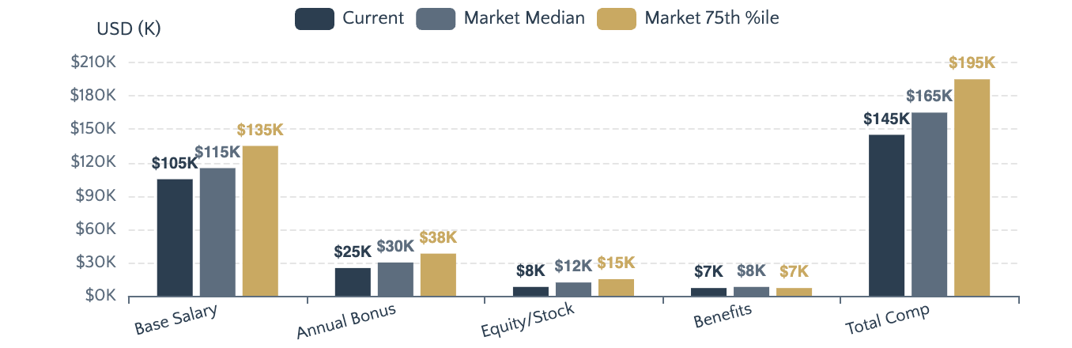
Positioning Assessment
Current Valuation & Positioning: Where We Stand Today
Honest assessment of current market position without ego inflation or excessive humility
Current Role vs. Market Rate Analysis
Positioning Assessment
UNDER-VALUED
Current market position
Capabilities exceed current role requirements
Compensation below market for skill level
Limited visibility outside immediate org
Portfolio not externally documented
Current Total Comp
Market Median
Market 75th %
Comparable Transactions
$145K
$165K
$195K
Base + Bonus
+14% Gap
Target in 12mo
Profile A
$175K
8 yrs exp, consulting → tech, Director level
Perceived vs. Intrinsic Value Gap
Profile B
$165K
Perceived Value
7 yrs exp, ops background, Senior Manager
How market sees
65%
Profile C
$190K
Intrinsic Value
82%
9 yrs exp, strategy + product, VP level
Actual capability
17% value gap = significant upside opportunity through better positioning
This Profile Positioning
$160-180K Range
With proper positioning & visibility

Slide 5
Asset Inventory
The Asset Inventory: What's on the Balance Sheet
Comprehensive inventory of tangible and intangible assets constituting the investment base
Hard Assets
Measurable
Soft Assets
Behavioral
Strategic Planning & Analysis
Expert
Leadership Track Record
Data Analytics & Visualization
Advanced
Led 12 cross-functional initiatives, 3 direct promotions, managed $8M+ budget
Project/Program Management
Expert
Communication & Influence
Presented to C-suite 15+ times, 90%+ stakeholder satisfaction scores
Stakeholder Management
Expert
Problem-Solving Pattern
Technical Implementation
Intermediate
Structured, first-principles approach. Documented: 40% efficiency gains, $2.3M cost savings
Credentials & Certifications
Learning Velocity
Consistently mastered new domains in 3-6 months. Self-taught: SQL, Python basics, design thinking
MBA, Top-15 Program
PMP Certified
Data Analytics Certificate
Agile/Scrum
Key Differentiator: Pattern of turning ambiguous problems into structured solutions with measurable outcomes
Network Assets
Relational
Reputation Assets
Perception
Quality Indicators
Institutional Affiliations
Brand Recognition
C-Level Contacts
12
Alumni: Top-tier consulting, Fortune 500
Known as "go-to problem solver" within 3 organizations. Reputation for delivery under pressure.
VP/Director Level
45+
Member: 3 professional associations
Social Proof & Testimonials
Cross-Industry
8 sectors
Active in 2 executive peer groups
12 written recommendations, 85+ LinkedIn endorsements, 4.9/5 internal feedback score
Geographic Reach
APAC, US, EU
Thought Leadership Footprint
Published 8 articles, spoke at 5 industry events, 2,500+ followers, content viewed 50K+ times
Network Value: 70% of past opportunities originated from warm introductions
Growth Opportunity: Reputation currently concentrated internally; external amplification = 3-5x value

Slide 6
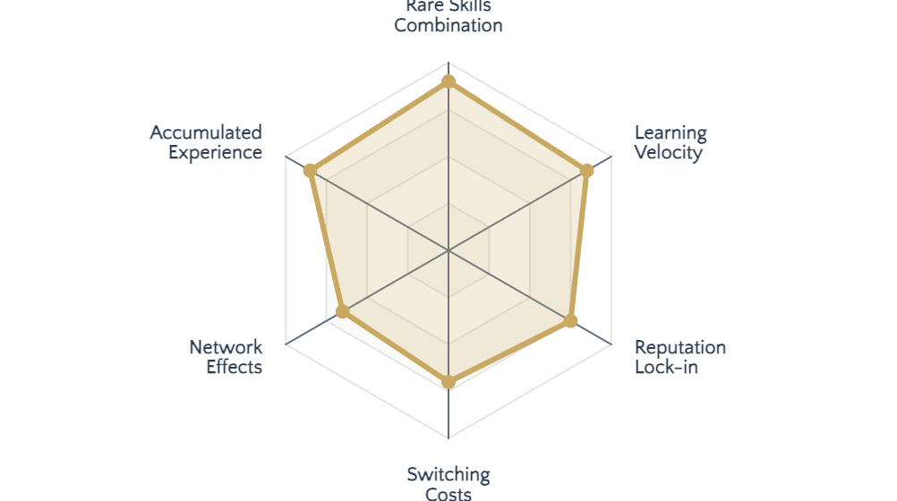
Competitive Advantage
Competitive Moat: Why This Can't Be Easily Replicated
Analysis of defensibility factors and durability against market forces
Moat Strength Analysis
Rare Combinations
Position at intersection of strategy, operations, and technology fluency creates scarcity premium.
<5%
8+ yrs
Have all three
To develop
Accumulated Advantages
Assets requiring long time to build and impossible to shortcut:
Pattern recognition across 50+ projects
Relationship trust built over years
Battle-tested frameworks and mental models
Switching Costs
Organizations that work with this profile experience:
6-12 mo
85%
To replace
Retention rate
Moat Durability Test
Overall Moat Rating
Durability Score
AI/Automation Threat
LOW ✓
STRONG
7.8/10
Commoditization Risk
MEDIUM ▲
Defensible position with 3-5 year protection window under normal market conditions
Industry Disruption
LOW ✓

Slide 7
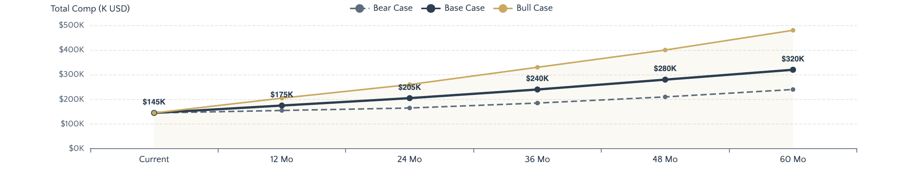
Growth Trajectory
Growth Thesis: The Compounding Story
Three-scenario analysis with milestones, warning signs, and probability assessments
Scenario Trajectory Analysis
Base Case
60% Prob
Bull Case
25% Prob
Bear Case
15% Prob
Steady execution of development plan with normal market conditions.
Key bets succeed: Thought leadership breakthrough + high-visibility project success.
Market downturn or key risks materialize. Conservative but still positive trajectory.
12
Months
Senior Manager/Director, $165-180K
12
Months
12
Months
36
Director/VP, $190-220K, industry recognition
Lateral move, $150-165K, skill building focus
Months
Director/VP, $200-240K, regional recognition
36
Months
36
Months
60
VP/SVP, $280-380K, national thought leader
Senior Manager, $175-200K, delayed promotion
Months
VP/Head of Function, $280-350K
60
Months
60
Months
C-Suite or founder, $400K+ or equity
Director, $220-260K, stable but slower
Milestones: 2 promotions, 3 published works, 10+ speaking engagements
Milestones: Viral content, keynote invitations, board/advisory roles
Triggers: Economic recession, industry disruption, health/personal issues

Slide 8
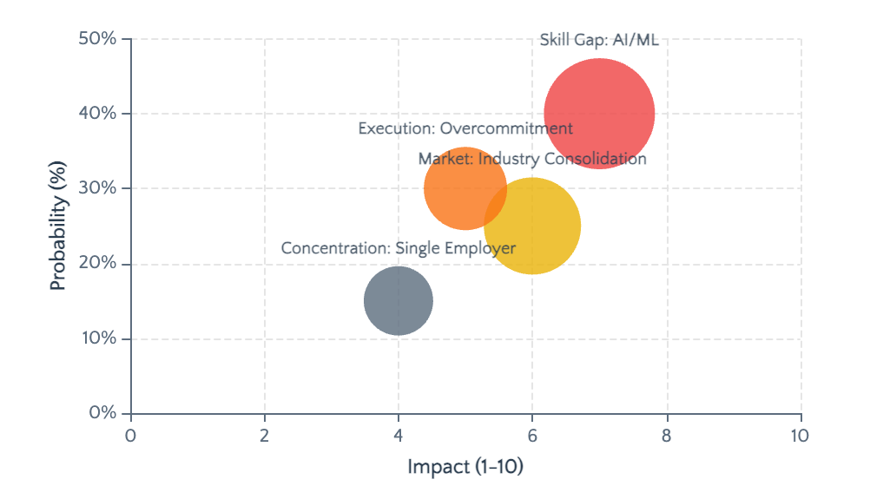
Risk Disclosure
Risk Factors: What Could Go Wrong
Honest disclosure of risks with probability, impact assessment, and mitigation strategies
Risk Matrix
Skill Risks
HIGH
40%
Gap: Technical depth in AI/ML implementation
Current: Conceptual understanding. Required: Hands-on implementation
Mitigation: $5K investment in certification + 2 projects
Market Risks
MED
25%
Industry consolidation reducing leadership roles
Economic downturn could freeze senior hiring for 12-18 months
Mitigation: Cross-sector positioning + advisory/consulting option
Execution Risks
MED
30%
Tendency to overcommit; perfectionism causing delays
Historical pattern: Taking on too much, quality suffers
Mitigation: Accountability partner + ruthless prioritization framework
Concentration Risks
LOW
15%
Risk Disclosure Principle
Over-dependence on single employer/industry
85% of income from one source; 70% of network in one sector
"The most credible investment memos are those that disclose risks with the same rigor as opportunities. Transparency builds trust."
Mitigation: Diversify income (advisory), expand network

Slide 9
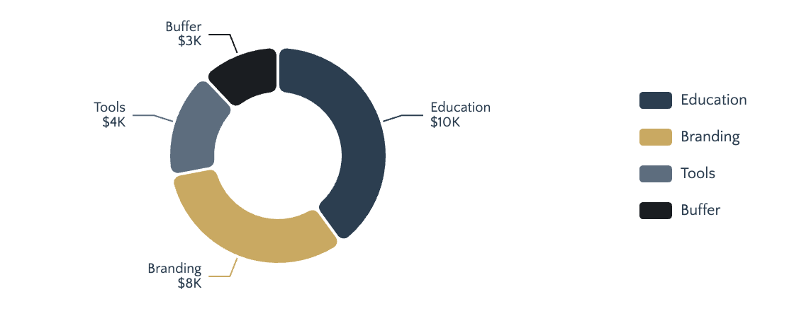
Capital Allocation
Use of Investment: Where Every Hour and Dollar Will Go
Detailed breakdown of investment allocation with expected returns per category
Investment Allocation Breakdown
Time Investment
18h/wk
8h
Skill Building
Courses, practice, projects
5h
Networking
Meetings, events, outreach
3h
Creating
Writing, speaking, building
2h
Reflecting
Planning, reviewing, adjusting
Financial Investment
$25K
Total Investment
Time Commitment
Expected ROI
$25K
18h
4.2x
Education & Certifications
$10K
Annually
Per Week
5-Year Return
Executive course, AI/ML cert, leadership program
Opportunity Cost Acknowledged
Personal Branding & Visibility
$8K
Conference fees, speaking coaching, content production
18 hrs/week = 936 hrs/year
Time not spent on leisure, relationships, or immediate income generation
Tools & Resources
$4K
$25K = 17% of disposable income
Software, subscriptions, equipment
Money not available for consumption, travel, or alternative investments
Career Transition Buffer
$3K
Trade-off consciously accepted
Short-term sacrifice for asymmetric long-term upside
Interview prep, networking events, potential gap
Social Capital Investment
3-5
2
20+
Key Mentors
Peer Groups
Deepened Relationships

Slide 10
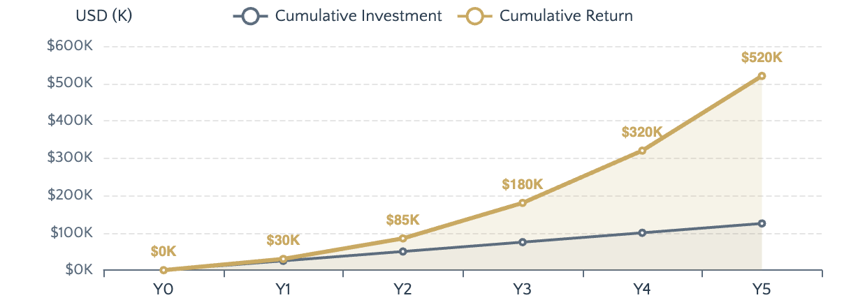
Return Analysis
Projected Returns: Specific, Not Vague
Concrete, measurable return projections across financial, career, reputational, and personal dimensions
Return Timeline with Milestones
Reputational Returns
Speaking Opportunities
Target: 3-5 keynotes/year by Y3
Advisory Roles
Target: 2-3 board/advisory positions by Y5
Thought Leadership
Target: 10K+ followers, recognized expert
Network Quality
Access to C-suite across industries
Financial Returns
Career Returns
Personal Returns
12-Month Salary
$175K
Roles Unlocked
Autonomy & Flexibility
Director → VP → SVP → C-Suite
Choice of projects, location independence, schedule control
36-Month Salary
$240K
Geographic Optionality
Impact Measurement
60-Month Salary
$320K
Global roles in 5+ cities
Direct line of sight to organizational outcomes
Sector Flexibility
Work-Life Integration
5-Year Total
$1.2M+
Tech, consulting, finance, healthcare
Financial security enabling intentional choices
Negotiation Power: 2-3x improvement
Total 5-Year Return
ROI Multiple
$1.2M+
4.2x
Conservative estimate. Bull case: 6-8x return

Slide 11
Support Ecosystem
The Investment Team: Who's Behind This
Quality of support ecosystem as a signal of investability and execution capability
Mentors & Advisors
Accountability Partners
Strategic guidance & domain expertise
Execution discipline & progress tracking
Senior Executive Mentor
C-Suite
Weekly Check-in Partner
25+ years in Fortune 100. Provides leadership coaching and organizational navigation.
Peer with similar ambition. Weekly 30-min calls to review progress and blockers.
Industry Expert Advisor
Domain
Quarterly Review Board
Recognized thought leader in target sector. Provides market intelligence and trend insights.
3-person panel (mentor + 2 peers). Quarterly 2-hour deep dive on goals and trajectory.
Technical Skills Mentor
Technical
Progress Tracking System
AI/ML practitioner. Guides technical skill development and project execution.
Public commitment to metrics. Monthly published updates on LinkedIn.
Champions & Sponsors
Learning Network
Door-openers & active endorsers
Peer acceleration & knowledge exchange
1
Former CEO Sponsor
Executive Peer Group
Technical Community
Provides introductions to C-suite network. Active endorser for senior roles.
12 senior professionals. Monthly meetups for challenge-solving.
AI/ML practitioner group. Bi-weekly knowledge sharing.
2
Board Member Champion
Nominates for advisory roles. Opens doors to board-level opportunities.
Alumni Network
Industry Association
3
Industry Influencer Advocate
MBA alumni. 500+ members, active in 3 cities.
Professional body. Quarterly conferences, working groups.
Amplifies thought leadership. Invites to speaking opportunities.

Slide 12
Verification
Due Diligence Package: Everything to Verify This Thesis
Structured evidence inventory available for scrutiny and verification
Portfolio of Work
Track Record Documentation
Strategic Initiative Case Studies
12 Docs
1
Career Progression Timeline
Detailed documentation of 12 major projects: objectives, approach, outcomes, lessons learned.
8-year trajectory: 4 promotions, 3 role expansions, compensation growth
Quantified Results Database
Metrics
2
Awards & Recognition
5 internal awards, 2 industry recognitions, 1 publication feature
Spreadsheet of 50+ measurable outcomes: revenue impact, cost savings, efficiency gains.
3
Performance Reviews
Work Samples & Deliverables
Portfolio
5 years of documented performance: consistently exceeds expectations
Anonymized strategy decks, analysis reports, implementation plans.
4
360-Degree Feedback
Aggregated feedback from 50+ colleagues: leadership, impact, collaboration
Public Intellectual Footprint
8
5
References & Endorsements
Published Articles
Speaking Engagements
Direct Manager References
2.5K
50K+
3 former managers available for detailed conversations
LinkedIn Followers
Content Views
Peer Testimonials
12 written recommendations from colleagues and collaborators
Assessments & Certifications
Client/Stakeholder Feedback
MBA - Top 15 Program
PMP Certified
Data Analytics Certificate
Agile/Scrum
Leadership Assessment
8 testimonials from internal and external stakeholders
360 Feedback

Slide 13
The Request
The Ask: What We're Seeking — Specifically
Precise articulation of investment needs with clear success metrics and investor returns
From Self
From Employer/Sponsor
Personal commitment & allocation
Organizational support & development
Time Commitment
18h/wk
Development Budget
Protected development time. Non-negotiable calendar blocks.
$15-20K annually for courses, conferences, certifications
Financial Allocation
$25K/yr
Stretch Assignments
Dedicated investment fund. No diversion for consumption.
High-visibility projects with P&L impact. Cross-functional scope.
Lifestyle Adjustment
Trade-offs
Strategic Introductions
Reduced leisure, delayed gratification, focused priorities.
Access to senior leadership, external partners, board members
Success Metric: 90%+ adherence to development plan
Success Metric: Promotion to Director within 12-18 months
From Mentor
From Investor/Funder
Guidance & network access
Capital & strategic involvement
Monthly Time Commitment
2-3 hrs
Capital Amount
$50-100K
Structured check-ins: strategy, challenges, career navigation
For career transition buffer, advanced education, or venture seed
Specific Introductions
Timeline
3-5 warm introductions to relevant contacts per year
12-24 month horizon with quarterly milestone reviews
Honest Feedback
Involvement Level
Brutal candor on blind spots, development areas, positioning
Monthly updates, strategic guidance, network access
Success Metric: Monthly progress + 3+ valuable introductions/year
Investor Return: Advisory fees, equity, or success-based compensation

Slide 14

Investment Conclusion
The Simplest Version
of Why This Makes Sense
This is an asymmetric bet on human capital compounding. The investment thesis rests on three pillars: (1) A rare skill-position combination in high-demand market, (2) A track record of converting capability into measurable outcomes, and (3) A disciplined approach to development with clear milestones and risk mitigation. The downside is capped—worst case, skills acquired remain valuable. The upside is uncapped—successful execution unlocks exponential career and financial trajectory.
<5%
4.2x
12-18
Have this skill combination
Projected 5-year ROI
Month window of opportunity
Why Act Now
Next Steps
Market conditions favor this profile today. Delay means competing in a more saturated landscape 2-3 years from now. The compounding clock starts when the investment is made—not when it's convenient.
1.
Schedule 30-minute thesis review conversation
2.
Review due diligence package and references
3.
Define specific investment terms and success metrics
Investment Memo
Contact
The Case for Investing in [Your Name]
[your.email@domain.com]
[LinkedIn Profile URL]

