Slide 1

Strategic Intelligence Document
Career Pivot
Intelligence Deck
War Room Analysis for Strategic Career Transition
Subkhan Ibnu Aji
March 2026
ASN → Private Sector/International
Confidential • Internal Use Only

Slide 2
The Reality Check
Why Pivot — The Honest Calculus
Not about disliking ASN. About a ceiling that doesn't match deliverable value.
Current ASN Trajectory
Market Rate for Subkhan's Profile
Golongan IV Base Salary
MBB Consultant (Post-MBA)
Rp 3.0–5.9M /month
$150–237K /year
≈ Rp 2.4–3.8B /year total comp
With Allowances (Senior)
Rp 15–40M /month
ADB International Staff (IS6-IS8)
$179–339K /year
10-Year Ceiling (Echelon I)
≈ Rp 2.9–5.5B /year + benefits
~Rp 60M /month max
AI Policy Consultant (Senior)
$140–225K /year
≈ Rp 2.3–3.6B /year
Hard ceiling regardless of performance or value delivered
Performance-linked growth, no artificial ceiling
Compensation Gap (Conservative Estimate)
10-Year Opportunity Cost
4–8x current earning potential
Rp 15–30B+

Slide 3
Competitive Positioning
Asset Inventory — What Subkhan Brings
Not a CV list. A competitive asset analysis: what the market cannot easily replicate.
Government Insider Access
SIBARU Track Record
Original IP (AAGIF & AGIR)
Active network across KemenPKP and broader government ecosystem. Decision-maker relationships that take years to build.
Operated autonomous AI system processing 500K+ real government data points. Production deployment, not theoretical.
Proprietary frameworks for AI governance. Original intellectual property that demonstrates thought leadership.
WHO PAYS PREMIUM:
WHO PAYS PREMIUM:
Intl. consultants, tech companies, multilateral orgs needing government navigation
AI policy roles, government digital transformation projects
WHO PAYS PREMIUM:
Think tanks, research institutions, consulting firms
PPTI Network
Dual Credentials
DNO + PhD Trajectory
1,500+ member community of IT professionals. Built and led from scratch. Demonstrates community leadership and reach.
MBA + S.Kom combination. Technical depth + business acumen. 50+ certifications demonstrating continuous learning.
Entrepreneurial execution proof (DNO). PhD trajectory for academic credibility and compensation multiplier effect.
WHO PAYS PREMIUM:
WHO PAYS PREMIUM:
Tech companies, ecosystem builders, platform businesses
WHO PAYS PREMIUM:
Research institutions, senior advisory roles, international orgs
Consulting firms, strategy roles, leadership positions
Key Insight: The combination of government access + AI expertise + business credential + research trajectory is rare. Most candidates have 2-3 of these. Subkhan has all 4.

Slide 4
Market Segmentation
Target Market — Who Pays Premium
Four employer categories most likely to pay premium for the Subkhan profile combination.
1
International Consultants
2
International Organizations
McKinsey, Deloitte, PwC, KPMG
World Bank, ADB, UNDP, GIZ
What They Need
What They Need
Public sector practice consultants who can speak bureaucracy AND AI. Bridge between government clients and technical teams.
Policy + technical + local government network combination. Researchers and advisors with insider access.
Compensation Range
Compensation Range
$179–339K/year
$150–237K/year
IS6-IS8 level + expat benefits
Post-MBA Associate level + bonus
Fit Score
Fit Score
90%
85%
3
Tech Companies
4
Think Tanks & Research
Microsoft, Google, AWS, Salesforce
CSIS, CIPS, Prakarsa, SMERU
What They Need
What They Need
Government vertical leaders who can sell AND deliver to government clients. Navigate procurement, build relationships.
Researchers with insider government data access for original research. Policy analysts with implementation experience.
Compensation Range
Compensation Range
$140–200K/year
$80–150K/year
Government Affairs / AI Policy roles
Lower comp but prestige + network
Fit Score
Fit Score
75%
80%

Slide 5
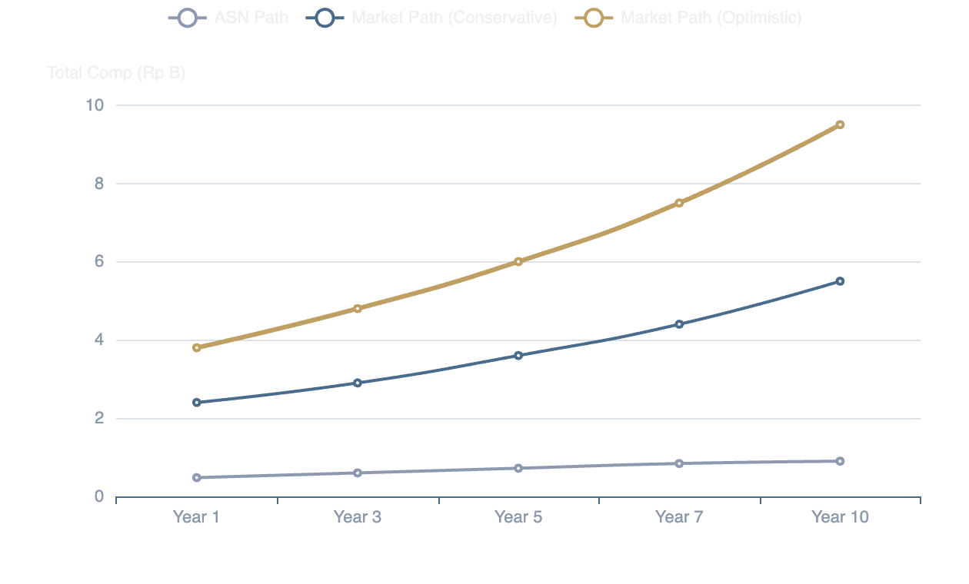
The Real Numbers
Compensation Intelligence
Concrete market data and opportunity cost analysis over 5-10 year horizon.
Compensation Trajectory Comparison
5-Year Opportunity Cost
ASN Path (optimistic)
Rp 3.6B
Market Path (conservative)
Rp 12–18B
Gap
Rp 8.4–14.4B
10-Year Opportunity Cost
ASN Path (Echelon I)
Rp 9B
Market Path (Senior)
Rp 30–50B
Gap
Rp 21–41B
Note: Market path assumes conservative 10% annual growth. PhD completion in 2031 adds 20-30% premium.

Slide 6
Strategic Positioning
Role Targeting — Optimal Archetypes
Three role types that maximize Subkhan's asymmetric advantage. Not applying to everything.
AI Policy Advisor/Consultant
Government Affairs & Strategy
Research Director / Principal Researcher
The Role
The Role
The Role
Bridge between government and AI industry. Advise on regulation, implementation, strategy.
Navigate regulation, build government relationships, drive public sector sales for tech companies.
Lead original research programs with government data access. Publish, advise, build thought leadership.
Compensation
Compensation
Compensation
$140–225K/year
$120–200K/year
$100–180K/year
Indonesia: Rp 2.3–3.6B/year
Indonesia: Rp 2.0–3.3B/year
Indonesia: Rp 1.6–2.9B/year
Key Skills to Highlight
Key Skills to Highlight
Key Skills to Highlight
SIBARU track record
KemenPKP network
PhD trajectory
AAGIF/AGIR frameworks
Procurement & policy knowledge
Government data access
Government stakeholder mgmt
Stakeholder management
Research methodology
GAP TO CLOSE:
GAP TO CLOSE:
GAP TO CLOSE:
International publication record, consulting case interview skills
Sales/commercial experience, tech industry knowledge
International publications, PhD completion
Strategic Note: Role 1 (AI Policy Consultant) offers highest comp + best PhD alignment. Role 2 offers fastest path but requires commercial skill build. Role 3 is PhD-dependent but builds strongest long-term credibility.

Slide 7
Market Entry
Positioning Strategy — How to Enter Market
Not applying like fresh graduate. Leveraging unique position strategically.
Inbound Positioning
Conference Circuit
Build personal brand as Indonesia's AI governance expert. Let opportunities come.
Venues to meet hiring managers and partners in person.
Existing Assets
Actions Required
AAAI / ACM AIES
• State of AI Indonesia deck
• Publish on website/LinkedIn
AI ethics & policy conferences. Submit paper or workshop proposal.
• Policy Brief series
• SEO optimize for "AI policy Indonesia"
• Speaker Kit
• Regular thought leadership posts
Indonesia Policy Forums
• CareerIntel platform
• Media commentary outreach
Bappenas, Kemenko events. Local networking, lower cost.
World Bank/ADB Events
Regional conferences in Asia. Target 1-2 per year.
Outbound Targeting
Identify and build relationships with decision makers before positions open.
Target: 20 Decision Makers
Approach Strategy
PhD as Positioning
• McKinsey/Deloitte partners
• LinkedIn connection + note
• ADB/World Bank directors
• Share relevant insights
Letters of intent to supervisors who can also open consulting/research doors.
• Tech co. gov affairs leads
• Request informational call
• Think tank research heads
• Offer Indonesia AI briefing
Target professors with industry connections and advisory roles.

Slide 8
Honest Assessment
Gap Analysis — What Needs Closing
Brutal honesty about what's missing for highest-tier compensation. No filter.
International Publications
CRITICAL
International Network
MODERATE
Current State
Current State
Limited international peer-reviewed publications. Mostly Indonesian-language outputs.
Strong Indonesia network, limited connections outside SE Asia.
Why It Matters
Why It Matters
Required for World Bank/ADB research roles and top-tier consulting credibility.
International orgs and MNCs value global professional network.
Timeline to Close
Timeline to Close
12–18 months for first Q1/Q2 journal article
6–12 months through conference circuit and LinkedIn outreach
WORKAROUND:
WORKAROUND:
Target consulting roles first (less publication-dependent), transition to research later.
Leverage Indonesia expertise as entry point; network builds organically.
Formal English Negotiation
MODERATE
Consulting Business Model
LOW
Current State
Current State
Fluent in daily communication, less practiced in high-stakes negotiation contexts.
Deep bureaucracy knowledge, limited exposure to consulting business models.
Why It Matters
Why It Matters
Compensation negotiation, client presentations, board-level communication.
Understanding utilization, project economics, client management differs from PNS.
Timeline to Close
Timeline to Close
3–6 months with focused practice (mock negotiations, presentations)
2–3 months of reading + case interview prep
WORKAROUND:
WORKAROUND:
Start with written communication; verbal fluency improves with exposure.
Learn on the job; many consultants came from non-consulting backgrounds.

Slide 9
Compensation Multiplier
The PhD Multiplier
PhD as compensation multiplier, not just academic credential. The numbers don't lie.
PhD Impact on Compensation
PhD Trajectory Timeline
ADB Principal Researcher
IS7-IS8
2026: Applications
Submit to top-100 programs. Leverage for positioning.
Without PhD
With PhD
$200–250K
$250–339K
Fall 2027: Program Start
25–35% premium
Begin PhD. Continue part-time consulting if possible.
MBB Senior Advisor
Partner Track
2031: PhD Completion
Without PhD
With PhD
Unlock senior research + principal advisor roles.
$300–400K
$400–600K
30–50% premium + faster promotion
Post-2031: Premium Tier
Access to highest compensation bands.
Think Tank Director
Research Leadership
Without PhD
With PhD
$120–160K
$180–250K
Lifetime Value Calculation
50%+ premium, role eligibility
PhD investment: 4 years + $100–200K opportunity cost. Lifetime earning premium: $2–5M+ (NPV). ROI: 10–25x

Slide 10
Execution Roadmap
90-Day Action Plan
First three months to initiate pivot without resigning from ASN. Weekly milestones matter.
M1
Month 1
M2
Month 2
M3
Month 3
Personal Brand Assets
Outbound Activation
Evaluate & Iterate
Website Launch
Decision Maker Mapping
Inbound Assessment
Professional site with portfolio, publications, contact
Identify 20 target decision makers across 4 categories
Track profile views, connection requests, inbound messages
LinkedIn Optimization
Approach 5 Targets
SEO-optimized headline, featured content, recommendations
LinkedIn + personalized note + value offer
Exploratory Conversations
Conduct 2–3 informational interviews with targets
Conference Submissions
Speaker Kit Finalization
Submit to 2 conferences (AAAI, ACM AIES, or regional)
Gap Analysis Update
One-pager, topics, past engagements, testimonials
Revise based on real market feedback received
PhD Outreach
Policy Brief Publication
Contact 5 potential supervisors with aligned research
Q2 Planning
Publish "State of AI Indonesia" deck publicly
Set next 90-day priorities based on learnings
SUCCESS METRIC:
Website live, LinkedIn profile views +50%, 1 published brief
SUCCESS METRIC:
SUCCESS METRIC:
3+ connections accepted, 1+ call scheduled, 1 submission
2+ meaningful conversations, updated strategy doc
Critical Constraint: All actions must be executable while maintaining ASN position. No public job search activity. Positioning only.

Slide 11
Decision Criteria
Decision Framework — When to Say Yes
Minimum criteria for accepting offer. Beyond just the salary number.
Compensation Threshold
Red Flags — Say No
Minimum Total Comp (Year 1)
🚩 Vague Role Definition
Rp 2.0B /year
"We'll figure out your role as we go" = career trap
≈ $120K USD — makes pivot worth the risk
🚩 High Turnover Team
Everyone has been there <1 year. Sign of dysfunction.
Must Include:
🚩 No Budget Authority
Base salary ≥ Rp 1.5B/year
"Advisor" role with no team, no budget, no influence.
Performance bonus potential
Health insurance coverage
🚩 Unrealistic Expectations
Professional development budget
"Transform our entire AI strategy in 3 months alone."
🚩 Compensation Games
Non-Negotiables
Heavy equity with low base, "unlimited PTO" with no culture.
Growth Trajectory
Clear path to senior role within 3–5 years. Not a dead end.
Decision Matrix
Intellectual Challenge
Compensation ≥ Rp 2B
Growth Trajectory Clear
Work that leverages full capability. Not repetitive or mundane.
REQUIRED
REQUIRED
PhD Research Relevance
Intellectual Challenge
PhD Alignment
Role supports or aligns with PhD research direction.
REQUIRED
PREFERRED
Long-Term Positioning
No Red Flags
Remote Flexibility
Strengthens, not weakens, future career options.
REQUIRED
NICE-TO-HAVE

Slide 12

Final Assessment
The Bottom Line
Pivot is not about escaping ASN — it's about capturing value that current path cannot deliver.
The Combination
The Window
Government insider access + AI expertise + MBA + research credentials + entrepreneurial track record
PhD trajectory adds credibility multiplier. CareerIntel platform demonstrates systematic thinking. Network at peak value.
= Rare & Marketable
= Timing is Right
The Real Question
Not whether pivot is possible — it's whether Subkhan is ready to make the move when the right opportunity arrives.
Document Version
Next Review
1.0 • March 2026
June 2026

